Slide 1
King County GOP Precinct Caucus Training

Slide 2
Overview
When, Where, and Contributions
What The Day Will Look Like
Credentialing
The Pooled Caucus Agenda
The Platform Discussion
The Precinct Caucus Agenda
Voting for Delegates and Alternates
Delegate Materials
Questions and Concerns

Slide 3
FAQs
When do the Precinct Caucuses take place?
Saturday, February 29, 2020 10:00 AM
Where do Precinct Caucuses take place?
Each PCO will be notified by February 3rd 2020 of their pooled caucus location by the KCGOP.
You will be able to find precinct and pooled caucus locations on the WSRP website: www.wsrp.org/caucus by February 3rd 2020
Please remember…
To reach out to all known Republicans in your precinct via phone and email to let them know about your caucus.

Slide 4
FAQs
Can the Precinct Caucus accept contributions?
Yes! Please ask for contributions to help defray the cost of Precinct Caucuses
* NOTE: Please make sure that contributions collected are noted on the Precinct Caucus Form next to the contributor’s name and placed in the envelope
If I’m a Precinct Chair (PC) should I caucus the precinct I chair?
NO. You must caucus in the precinct where you are registered to vote.

Slide 5
FAQs
Your Pooled Caucus Chair will be the point of contact for any questions you may have the day of your Precinct Caucus.
Please arrive early and be prepared to pitch in to help where needed to insure a smooth caucus for all.

Slide 6
What the day will look like…
9:00 AM - Caucus participants should arrive/locate caucus materials
10:00 AM – Pooled caucus will be called to order by temporary chairman
Pledge of Allegiance
Appointment of temporary secretary
Election of permanent caucus chairman
Election of permanent caucus secretary
Resolutions and platform discussion.
Other business, if necessary
10:30 AM - Adjournment to individual precinct caucuses
Now in individual precinct caucuses:
Call to order
Appointment of temporary secretary
Election of permanent caucus chairman
Election of permanent caucus secretary
Nomination and elections of delegate(s)
Nomination and elections of alternates(s)
Adjournment.
Important: Please make sure all form are filled out completely and are LEGIBLE.

Slide 7
Credentialing Basics
Who Can Participate in Precinct Caucuses?
Any member of the Republican Party who is a duly registered voter and legal resident of that precinct.
What does this mean?
“member of the Republican Party” – this means when a registered voter who checks into the precinct caucus by signing the registration sheet swearing an oath that they are a Republican.
“duly registered voter” – a person must be currently and verifiably registered to vote.
“legal resident of that precinct” – in order to participate that a specific precinct caucus, the voter must be registered in that precinct. The voter roll must reflect that this is where the person is in fact registered to vote.

Slide 8
Credentialing Basics: The Credentialing Process
To participate, a voter MUST…
Proof of identification and voter registration: Verifiable voter registration, preferably voter registration card or printed registration from King County Elections, AND a valid Washington State drivers license.
Each District will make arrangements for their pooled caucus locations to have internet access to look up voter status of participants who need help with their precinct information.
The first person nominated to run their individual precinct caucus must verify credentials.

Slide 9
Credentialing Basics: Key Points
The participant CANNOT sign the sign-in/oath sheet until it has been verified that they are eligible to participate and are in the proper precinct.
All paperwork must be completed and turned in to the pooled caucus chair to ensure your precinct’s delegation is eligible to the Legislative Caucus and KCGOP Convention.

Slide 10
Agenda ~ Pooled Caucus
PRIOR TO INDIVIDUAL PRECINCT CAUCUSES:
Call to order
Pledge of Allegiance
Appointment of temporary secretary.
Election of permanent caucus chairman.
Election of permanent caucus secretary.
Resolutions and platform discussion.
Such other business as may be appropriate for the caucus.
Adjournment to individual precinct caucuses.

Slide 11
Agenda ~ Precinct Caucus
Call to order
Appointment of temporary secretary
Election of permanent caucus chairman, if necessary **
Election of permanent caucus secretary, if necessary
Nomination and election of delegate(s)
Nomination and election of alternate(s)
Such other business as may be appropriate for the caucus
Adjournment
**The PCO (elected or appointed) shall be the chair of the precinct caucus

Slide 12
The Precinct Caucus
What happens?:
The Precinct Caucus is called to order directly following the adjournment of the pooled caucus agenda.
Precinct Caucus must follow the agenda supplied in the Precinct Caucus Packet
Caucuses with more than 10 attendees must elect a caucus secretary
VOTING SHALL BEGIN no earlier than 10:30am and no later than 11:30am: this is the key element of the precinct caucuses.
Adjournment

Slide 13
Voting for Delegates and Alternates
The PCO is an Automatic Delegate to the Legislative Caucus and the KCGOP Convention.
The PCO’s name should be written into the Automatic Delegate Section of the Caucus Form.
With the exception of the PCO, all precinct caucus attendees are eligible to be elected as delegates or alternates only.

Slide 14
Voting for Delegates and Alternates
The number of delegates and alternates for each precinct will be clearly indicated on the Precinct Caucus Packet and on the triplicate delegate sheet.
To be elected, a delegate must receive a majority (50% plus 1) vote. If there is one person in a Precinct, that person votes for himself and he/she is elected.
There may be contested races
It is important to note: you do not have to vote for anyone, if that is your choice.

Slide 15
Voting for Delegates and Alternates
Election of Alternates
Each alternate position must be voted on individually and recorded on the Precinct Caucus Form in the order elected.
DO NOT vote for all Alternate Candidates in one vote as a block and record on the caucus form in order of votes received
Any vacancies in the Delegate positions at the Legislative Caucus or Convention will be filled with an Alternate Delegate in the order they are elected.
Complete the Precinct Caucus Form and make sure the chairman of the precinct caucus signs the form. Important: THE FORM MUST BE COMPLETE AND SIGNED OR IT MAY NOT BE COUNTED.
When the Delegate and Alternate Delegate election is completed, sign all the forms. At that point the group is adjourned.

Slide 16
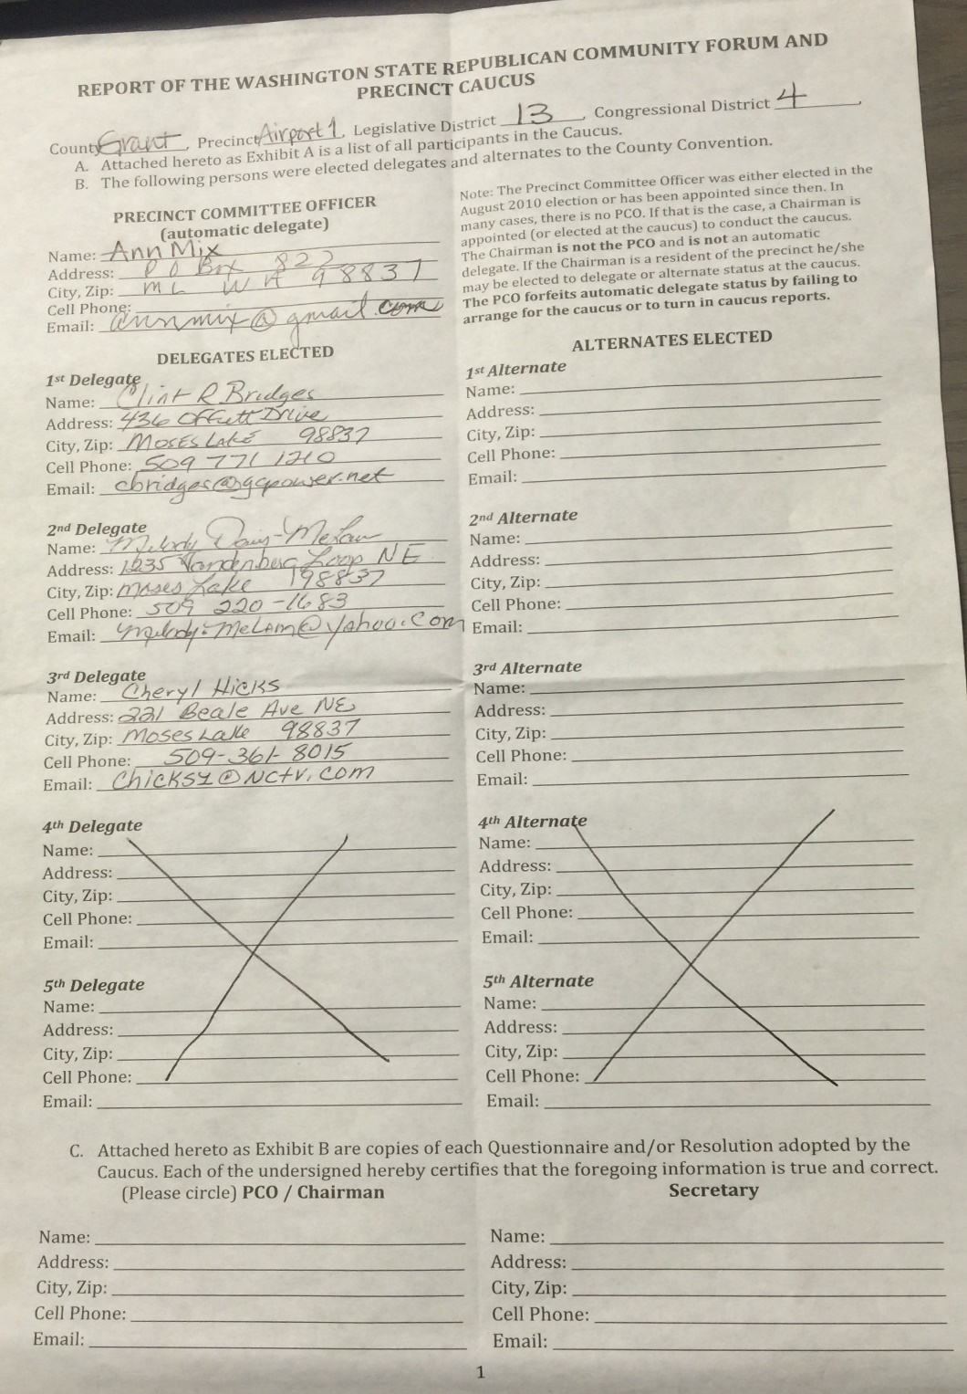
Precinct Caucus Report
Precinct caucus form:
*Make sure the form clearly notes your assigned precinct.
PCO/chairman info.
Each delegate and all their information is filled out.
Name
Address
Phone
Email
Each alternate with complete information
PCO or Chairman
Elected Secretary

Slide 17
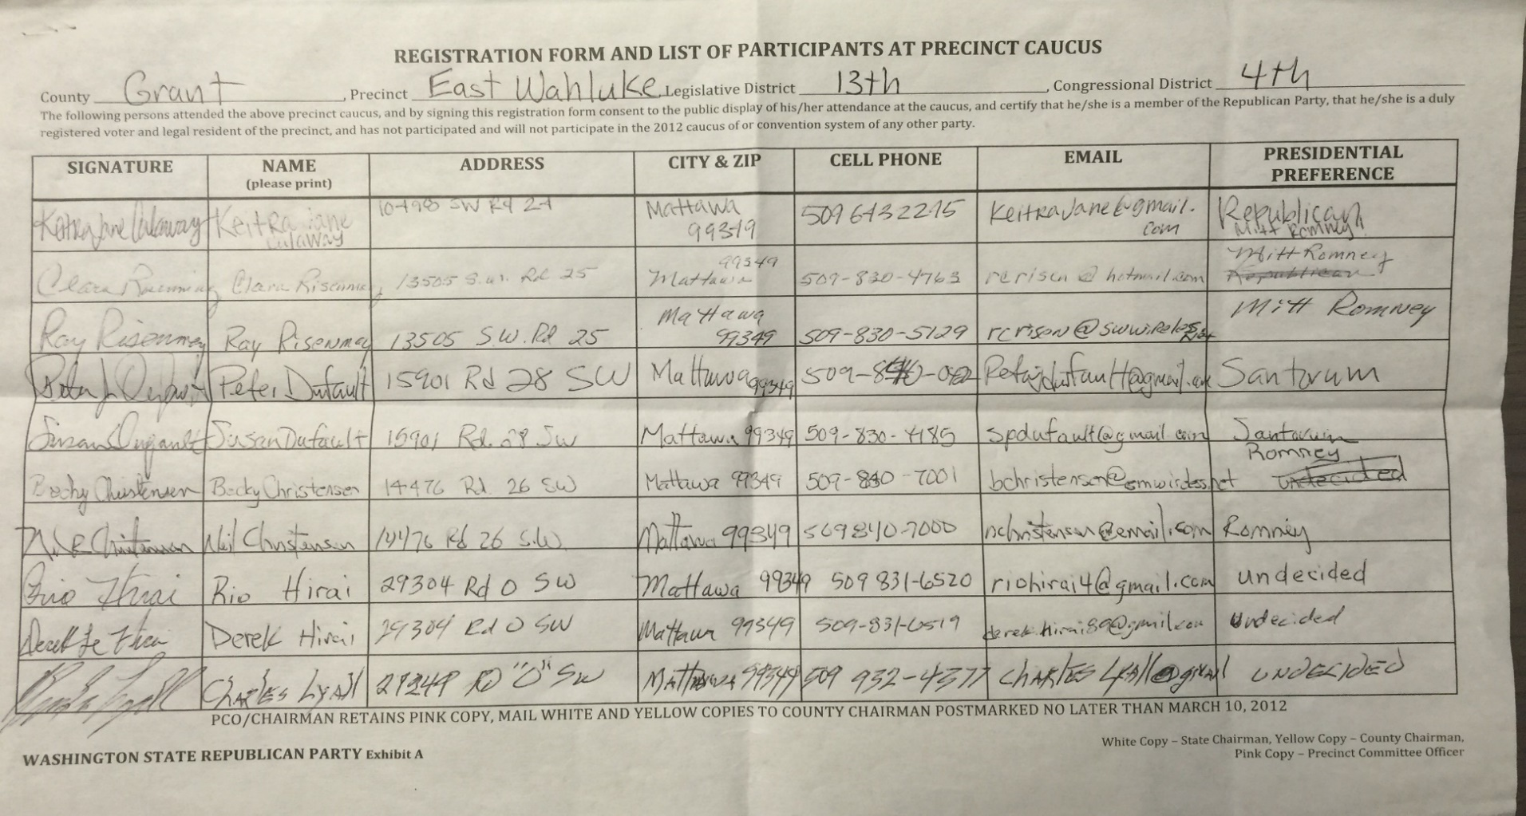
Registration Sheet
Registration/Sign In Sheet:
Each participant much completely fill out the precinct caucus registration form.
Why is this so important?
When looking for possible PCOs or help on campaigns, this is going to be a great starting point. Thus we want the information to be as accurate and legible as possible.

Slide 18
Questions?

